Slide 1
Homogeneity
The assumption of homogeneity is violated.

Slide 2
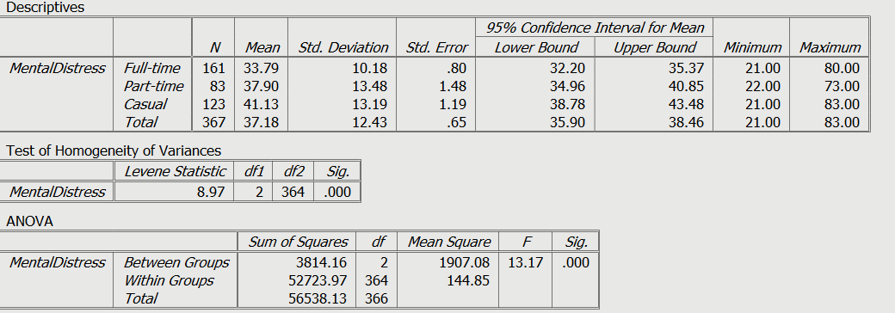
PSPP Output – Main effects

Slide 3
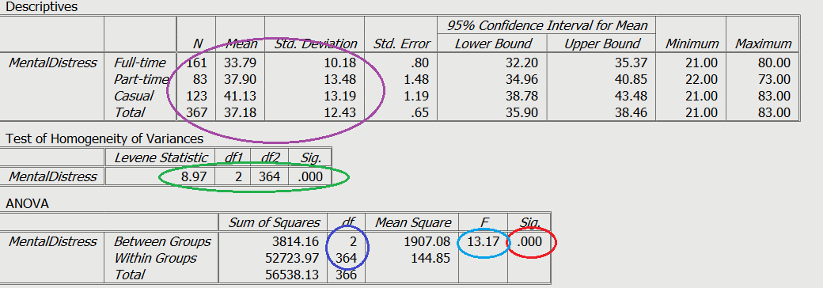
PSPP Output

Slide 4
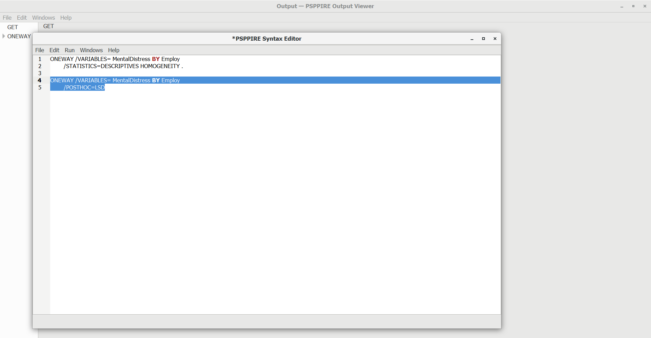
Posthoc Tests

Slide 5
Posthoc Tests - Results
Multiple comparisons report the significance test of mean differences of all possible pairs
Refer to Field for the most appropriate procedure given the situation and consideration of what is more important:
control over familywise error or
greater statistical power

Slide 6
Posthoc Tests - Results

