Slide 1
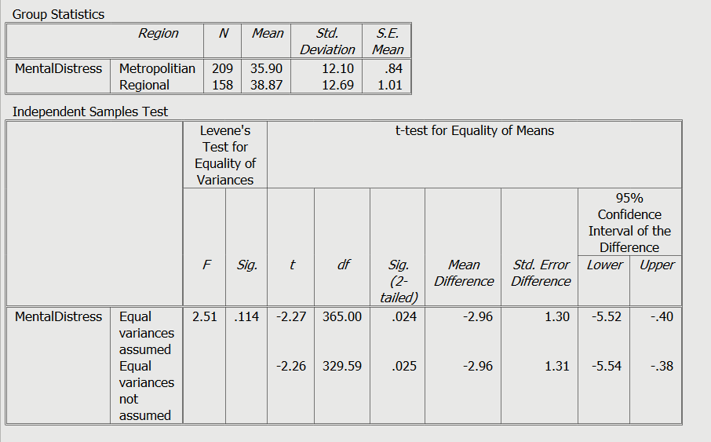
Independent Samples T-test

Slide 2
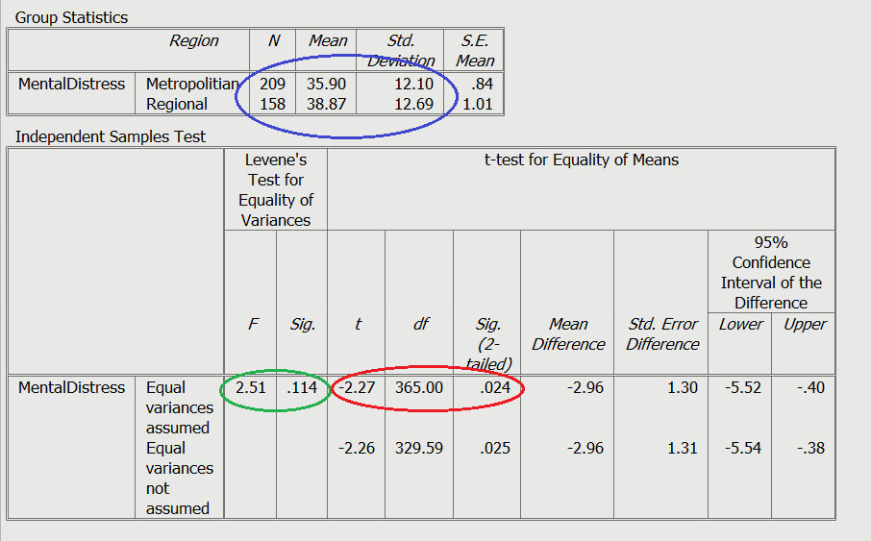
Independent Samples T-test
Things to look at:
Levene’s test (should be p>.05)
p value (<.05 means significant difference).
Mean scores
Effect size (calculated here: https://www.socscistatistics.com/effectsize/default3.aspx)

