Slide 1
Moderation and Mediation
Some predictor variables interact in a sequence, rather than impacting the outcome variable singly or as a group (like regression).
Moderation and mediation is a form of regression that allows researchers to analyse how a third variable effects the relationship of the predictor and outcome variable.

Slide 2
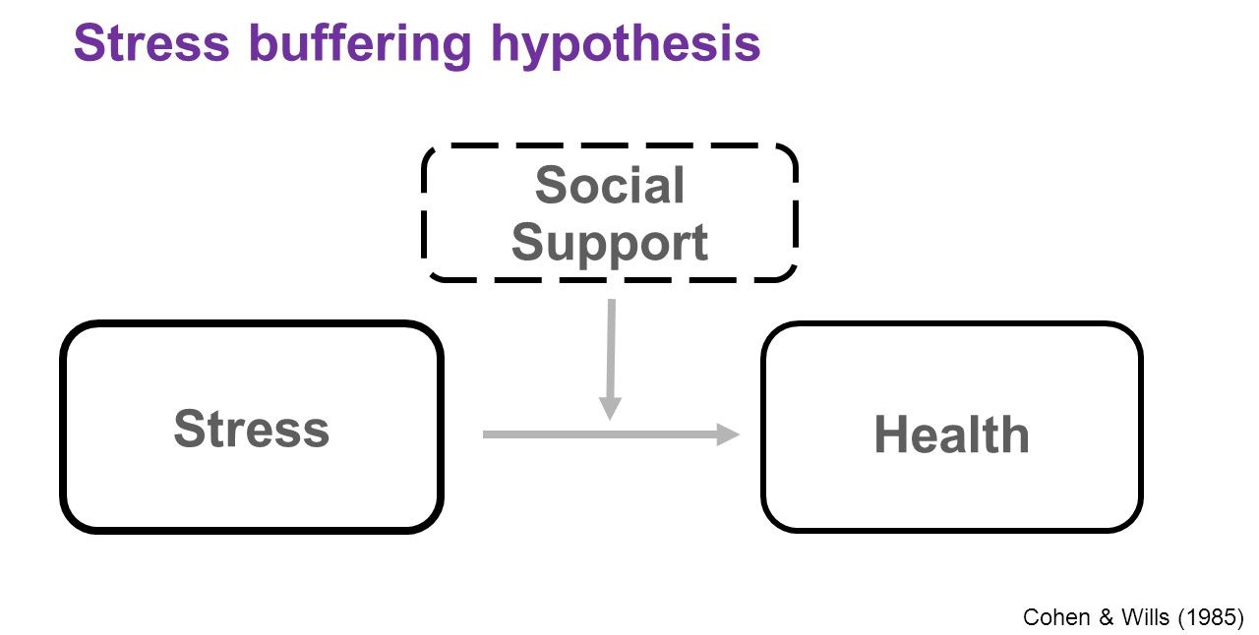
Moderation and Mediation
Consider the model below:
High levels of stress can negatively impact health.
Social support can mediate the effect of stress on health.

