Slide 1
Concern: Can you help us with similar shareable resources for multicultural early years education?
‘Being culturally competent doesn’t mean denying our own culture or having to know everything about all cultures. Rather, it is about being willing to find out more about the cultural identities of the children and families in our community ….’ Educators’ Guide to the Early Years Learning Framework for Australia

Slide 2
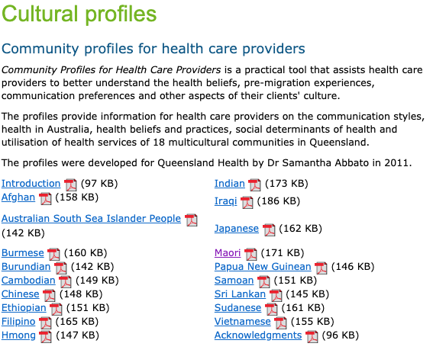
Queensland Health – Multicultural Health
Access this resource at:
https://www.health.qld.gov.au/multicultural/health_workers/cultdiver_guide
Screenshot from Queensland Health used under CC-BY

Slide 3
Queensland Health – Food and Cultural Profiles
Access this resource at:
https://metrosouth.health.qld.gov.au/multicultural-nutrition-resources
Screenshot from Queensland Health used under CC-BY

Slide 4
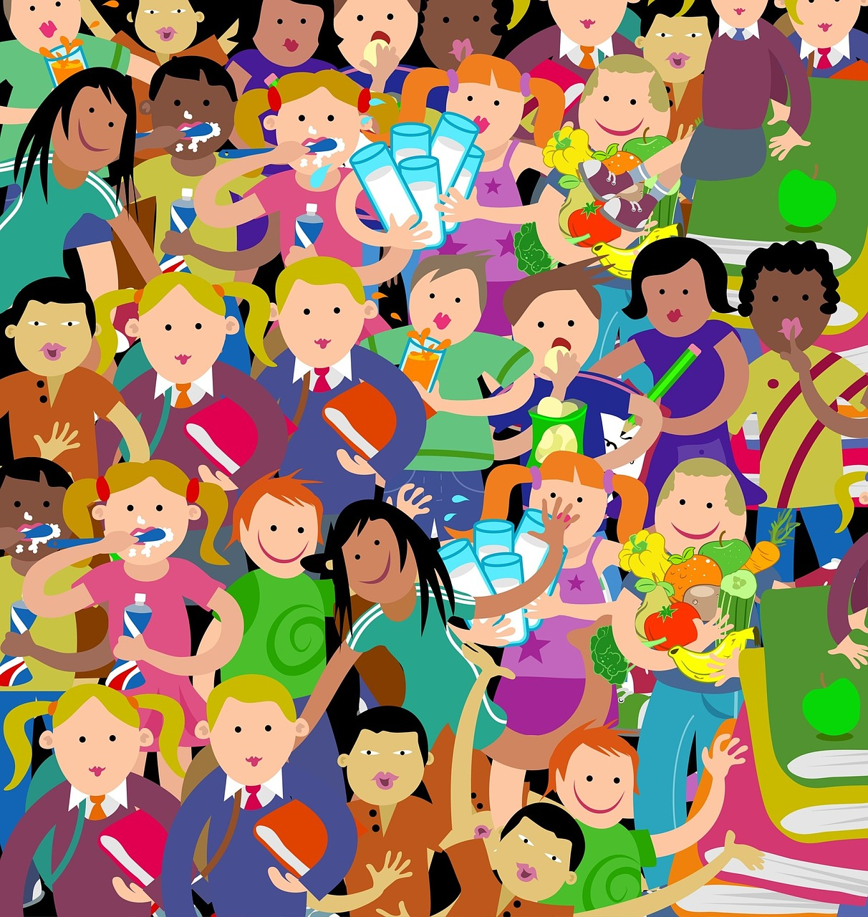
Child Australia – Cultural Connections Booklet
Access this resource at: https://https://childaustralia.org.au/wp-content/uploads/2017/02/Cultural-Connections.pdf
Image: Prawny, Cartoon Kids Children used under CC-BY

Slide 5
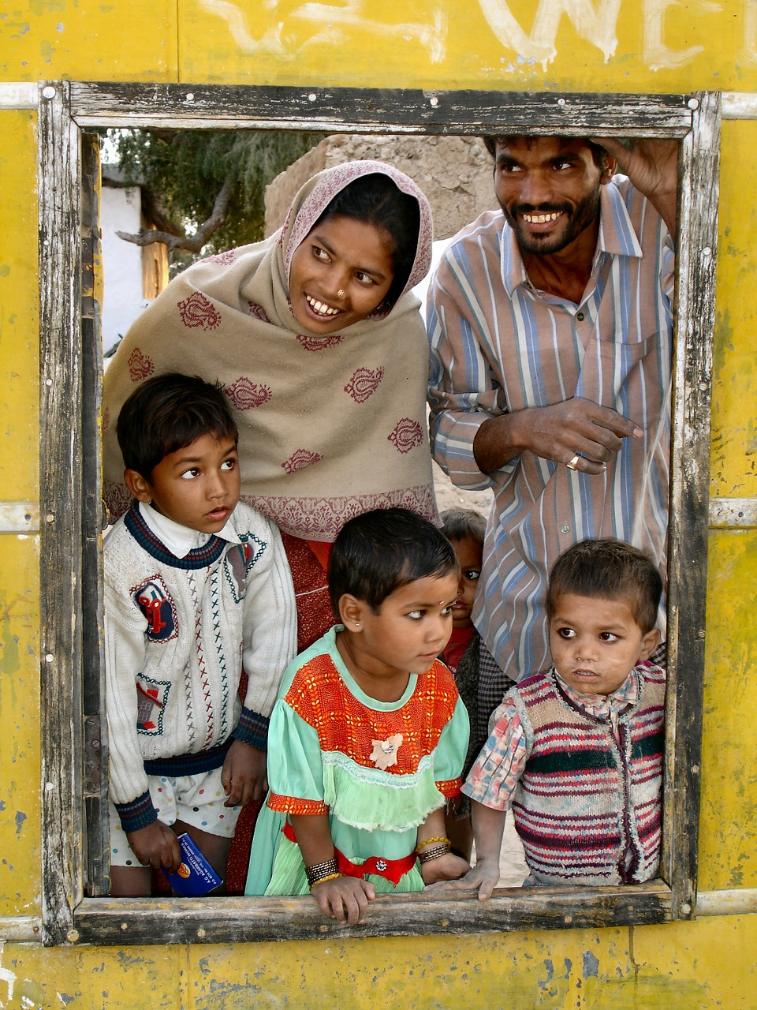
Welcoming conversations with culturally and linguistically diverse families - An Educators Handbook
Access this resources at: https://www.ecrh.edu.au/docs/default-source/resources/ipsp/welcoming-conversations-with-culturally-and-linguistically-diverse-families-an-educators-guide.pdf?sfvrsn=6
Image: Dassel, Indian Family, used under CC-BY

Slide 6
Keep adding to this collection for your own professional development of cultural competency
z

